Slide 1

Team Details
Team name - INVICTUS
Team leader name – Gowtham M
Problem Statement – AI + Cybersecurity & Privacy
🔐 “Securing Intranet Communication with AI-Driven Intelligence”

Slide 2

Breif about the idea : AI Ciperbridge
🔒 Zero-Trust E2E Encryption: Secure communication for smart campus intranets and connected legacy lab devices against internal network threats.
📦 Isolated Smart Routing: Containerized message flow engineered to completely isolate and protect sensitive university research data.
🛡️ Triple-Lock Security: AES-256 payload encryption, HTTPS secure routing channels, and strict Token-based device authentication.
🤖 Privacy-First Dual AI Engine: Localized Deep Learning models optimized for real-time campus traffic and advanced payload anomaly detection.
🔌 Cloud-Independent Edge Inference: 100% on-premise AI processing ensuring absolutely zero exposure of sensitive student PII to external clouds.
🏗️ Explainable Security-by-Design: A highly scalable, proactive defense framework featuring plain-language GenAI threat alerts for immediate IT action.

Slide 3
Opportunities
🔥 What Makes AI CipherBridge Different?
🔐 Zero-Trust secure access flows for campus labs & clubs
🧠 Privacy-preserving Edge AI anomaly detection
📦 Container-level isolation for sensitive research data
🌐 100% on-premise inference with zero raw PII exposure
🗣️ Explainable GenAI alerts for clear campus IT guidance
🌍 Market Opportunity
🏭 Smart campus and lab IoT devices lack internal encryption ⚠ Internal university intranet traffic is often unmonitored 📉 Traditional firewalls focus only on the network perimeter 📜 Compliance (FERPA / GDPR) requires strict student data privacy 🚀 Growing demand for privacy-preserving edge AI solutions
✔ Eliminates blind spots inside the university intranet
✔Detects compromised lab sensors and malware instantly
✔ Prevents lateral attacks on sensitive research data
✔ Provides structured, privacy-compliant data routing

Slide 4
List of features offered by the solution
Core Features
🔐 End-to-End AES-256 Encrypted IoT Communication
🔑 Zero-Trust Token-Based Device Access Control
📦 Isolated Docker Containerized Message Routing
🧠 Privacy-Preserving Dual AI Security Engine
📊 Real-Time AI-Driven Traffic & Payload Analysis
📝 Explainable AI Threat Logging & Audit Trail
🌐 Resilient Cloud-Independent Offline Edge Support
USP
⚡ Ultra-lightweight & instantly deployable on low-cost edge gateways and AMD hardware.
🎓 Designed specifically for university research labs and smart campus environments.
🛡️ 100% On-Premise Privacy: Federated learning ensures sensitive student PII never leaves the classroom.
🗣️ Explainable GenAI Alerts: Translates complex network threats into simple, actionable IT guidance.

Slide 5
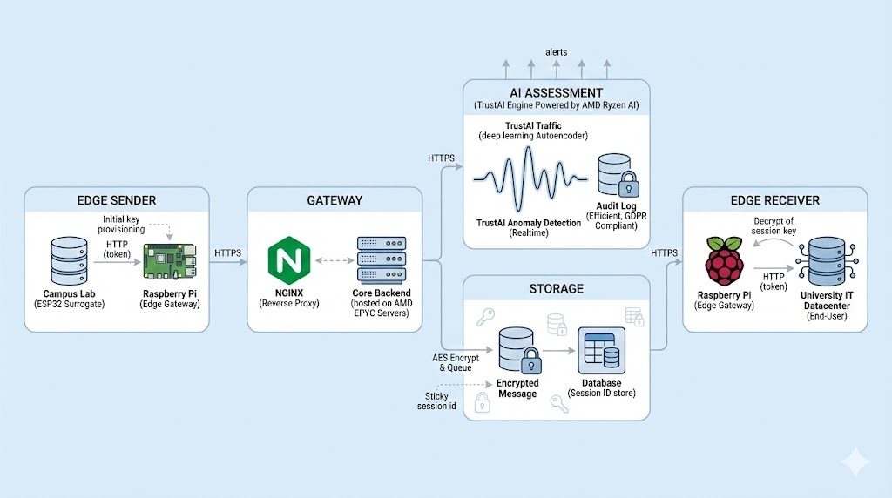
Process flow diagram

Slide 6
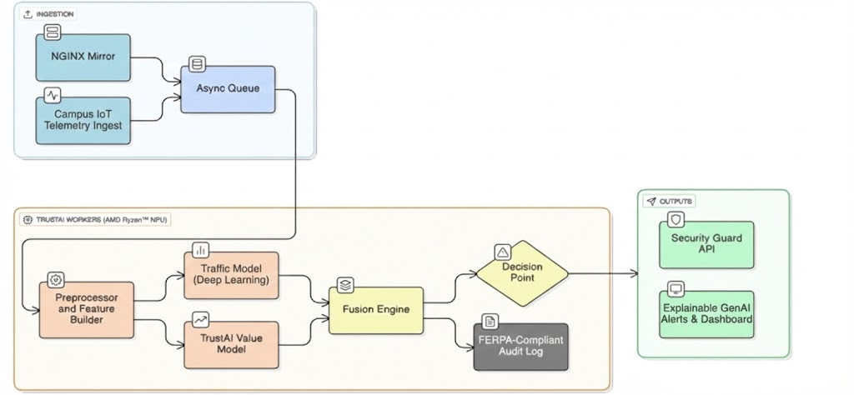
Architecture diagram of the proposed solution

Slide 7
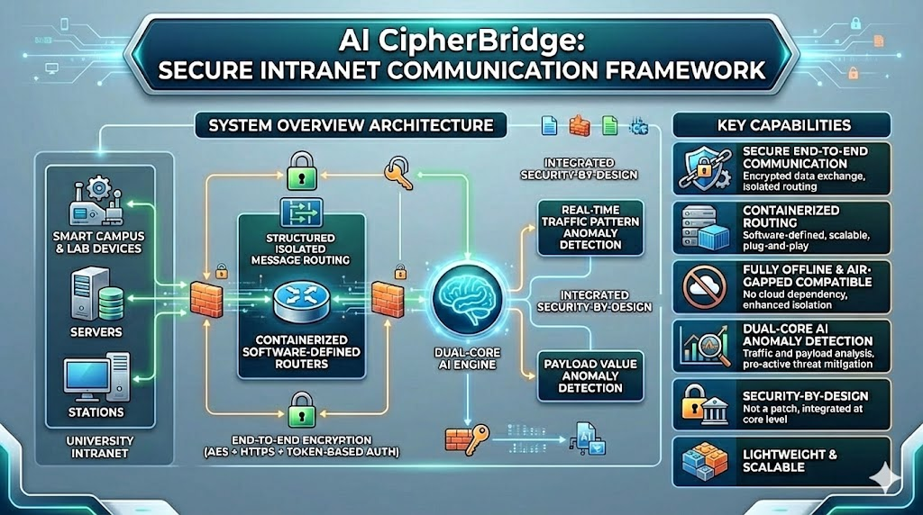
Architecture diagram of the proposed solution

Slide 8
Technology Stack
🧠 AI & Deep Learning
PyTorch & Scikit-Learn: Autoencoders & Isolation Forest for temporal anomaly detection.
ONNX Runtime: Optimizing models to run locally on AMD Ryzen™ AI NPUs.
Local GenAI (Llama-3): Generates plain-language, explainable security alerts.
🛡️ Security & Cryptography
AES-256 & PyCryptodome: End-to-end payload encryption executed at the campus edge.
Zero-Trust Auth Layer: Cryptographic token-based authentication.
🐳 Edge Infrastructure
Docker & NGINX: Containerized routing and reverse proxy firewalls for network isolation.
Hardware Surrogates: ESP32 (simulating lab sensors) and AMD Edge Nodes (local gateways).
⚙️ Core Backend & Databases
Python (Flask): High-throughput, asynchronous API handling.
Cassandra & Redis: Decentralized Data Lake (historical telemetry) and in-memory caching (real-time threat blocking)

Slide 9
Usage of AMD Products/Solutions
🖥 AMD Ryzen™ AI (Edge Inference) :Federated Learning models run directly on local Ryzen™ NPUs inside university labs. This enables ultra-low-latency threat detection while guaranteeing raw student PII never leaves the room.
⚙️ AMD EPYC™ (Core Campus Gateway) :Leveraging massive multi-core processing to handle simultaneous AES-256 decryption, Zero-Trust session management,and Docker routing for thousands of concurrent campus devices without latency.
🧠Ryzen AI Software Stack : Utilizing the ONNX runtime to accelerate our Deep Learning Temporal Autoencoders and Local GenAI models for immediate, explainable threat detection.
📈 Optimized Edge Orchestration : AMD’s robust compute environment ensures our containerized network (Docker/NGINX) runs flawlessly, providing strict isolation to prevent lateral malware attacks between research departments.

Slide 10
Estimated implementation cost
Retrofit Edge Gateways (~$15 per device)
ESP32-based hardware securely retrofits existing legacy lab equipment, avoiding massive hardware replacement costs for the university.
On-Premise AI Nodes (~$600 per lab/building)
Deploying AMD Ryzen™ AI-powered mini-PCs for local inference eliminates expensive, recurring cloud-compute API fees.
Core Campus Infrastructure (~$4,000+ one-time)
Centralized AMD EPYC™ enterprise server to manage the university intranet, handling high-volume decryption, routing, and decentralized storage.
Software Licensing ($0 Recurring)
Utilizing an open-source core architecture (Docker, PyTorch, Local Llama-3 SLMs) ensures zero vendor lock-in and maximizes educational IT budgets.

Slide 11
Revenue Model (B2B Enterprise SaaS & Hardware)
🛠️ Hardware Integration (One-Time CapEx)
Direct sales of pre-configured ESP32 Edge Gateways.
On-premise AMD Ryzen™ AI mini-servers with a standard markup.
🔄 Software Licensing (Annual Recurring Revenue)
Tiered SaaS subscription based on the number of secured labs/devices.
Includes continuous TrustAI threat intelligence updates.
🛡️ Premium Support & Compliance (Upsell)
Enterprise SLAs (Service Level Agreements).
24/7 GenAI security reporting and instant FERPA/GDPR audits.
💡 Core Business Value
Creates high-margin, sticky recurring revenue.
Eliminates unpredictable, expensive public-cloud API fees for universities

Slide 12
Prototype Assets (Optional)
GitHub Public Repository Link
Demo Video Link (Max: 3 Minutes)
Type here

Slide 13


